Slide 1
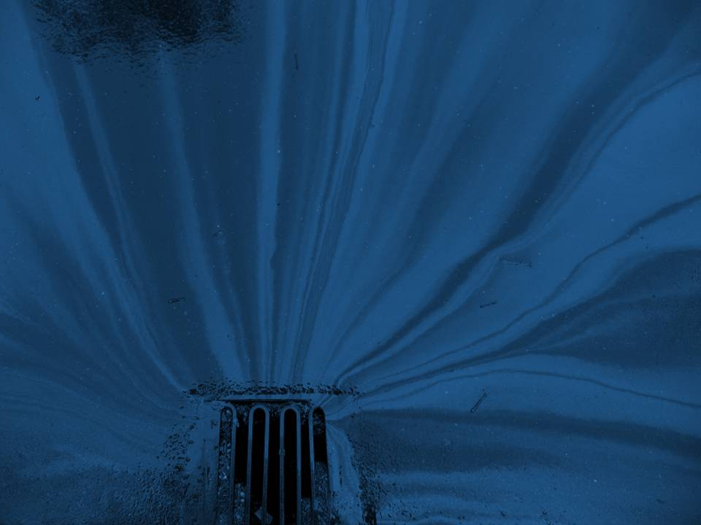
2021 OKR04
Minimum Control Measures
(MCMs)
Part 3 of Stormwater 101 Training
Prepared by INCOG for
Green Country Stormwater Alliance (GCSA)
January 2021
Notes:
Welcome to the 3rd of 4 Workbooks addressing the basics of stormwater permitting in Oklahoma, including city and county requirements under your permit.
Part 3 will cover the six Minimum Control Measures (MCMs) in the latest draft of the OKR04 permit which will be finalized in early 2021.
MCMs are categories of requirements that must be implemented by all OKR04 permittees.
OKR04 has other requirements that must also be met, but these 6 MCMs represent the fundamentals of stormwater permitting that apply to all permittees.

Slide 2
Where are MCMs Found In the 2021 OKR04 Permit?
Part I
Definitions and Acronyms.
Part II
Eligibility, Endangered Species.
Part III
Applications, MS4 Categories.
Part IV
Special Conditions (303d, TMDLs, ORW).
Part V
SWMP and MCMs.
Part VI
Monitoring, recordkeeping & reporting.
Part VII
Standard permit conditions.
Part VIII
Optional 7th MCM for MS4 construction.
Change
2021 OKR04 uses a new numbering system.
Notes:
The 2021 OKR04 General Permit is around 50 pages in length, including title page, 8 major Sections called “Parts”, and 11 pages of 4 appendices as “Exhibits”.
Part I has become “Definitions and Acronyms” that were Part VII in the 2015 OKR04 permit.
Part II has been reorganized to consolidate basic permit eligibility and limitations on coverage. It also includes how to address endangered species.
Part III describes the application process, timelines, and DEQ’s notification of coverage. It also includes the new MS4 Categories definitions.
Part IV is “Special Conditions” and compliance with Water Quality Standards. This Part covers 303(d) impaired waters, TMDLs and Outstanding Resource Waters (ORW).
Part V describes requirements for preparing the Stormwater Management Program (SWMP) document, including its contents. Part V.C also includes all 6 MCMs.
Part VI addresses requirements for monitoring, recordkeeping and reporting. It includes monitoring Quality Assurance (QA) measures and requirements for preparing Annual Reports.
Part VII covers all of the routine permit compliance conditions that are applicable to General Permits.
Part VIII lists requirements for the “7th MCM”, a permit option MS4s may elect to use for local municipally owned construction activities.
The OKR04 document numbering system has also changed. For example, Part IV.C with the 6 MCMs will become Part V.C in the 2021 OKR04 permit.

Slide 3
2015 OKR04 Six MCMs
The 6 MCMs in OKR04 Part IV.C:
Public Education and Outreach Program.
Public Participation and Involvement.
Illicit Discharge Detection and Elimination.
Construction Site Stormwater Runoff Control.
Post-Construction Management In New Development and Redevelopment.
Pollution Prevention / Good Housekeeping for MS4 Operations.
Notes:
This table lists the 6 MCMs in the present (2015) OKR04 Part IV.C:
Public Education and Outreach: This MCM provides education and community outreach on what can be done to help reduce stormwater pollution.
Public Participation and Involvement: This MCM provides opportunities for citizens, schools and businesses to participate in local pollution reduction activities.
Illicit Discharge Detection and Elimination (IDDE): This MCM directs the MS4 to inspect for, investigate and eliminate stormwater pollution.
Construction Site Runoff Control: This MCM requires the MS4 to control the discharge of sediment and other pollutants from active construction sites that disturb 1 acre or more (≥ 1 acre)
The MS4 also must address construction sites with smaller disturbance if they are part of a larger “Common Plan of Development”.
Post-Construction Management In New Development and Redevelopment: This MCM requires MS4s to implement strategies that will reduce stormwater pollution from the project once active construction has been completed, commonly by using Low Impact Development (LID).
Pollution Prevention / Good Housekeeping For MS4 Operations: This MCM requires that the MS4 apply pollution inspection and control to its own MS4 operations, including MS4-owned facilities, staging areas, parks and the stormwater collection system itself.

Slide 4

2021 OKR04 Proposed MCM Changes
The draft 2021 OKR04 Part V.C proposes these MCM Changes:
Public Education and Involvement. (Combines former MCMs 1 & 2)
Industrial Stormwater Runoff Control. (new MCM, for Category 3 only)
Illicit Discharge Detection and Elimination.
Construction Site Stormwater Runoff Control.
Post-Construction Management In New Development and Redevelopment.
Pollution Prevention / Good Housekeeping for MS4 Operations.
Notes:
The draft 2021 OKR04 permit proposes to amend the 6 MCMs under Part IV.C (which will become Part V.C) by combining the existing Part I and II into a new Part I, and by adding a new MCM for industrial stormwater runoff control.
The other 4 MCM categories are not being rearranged or renumbered.
The new MCM-1 will cover both public education and public involvement, and they are being combined because they are similar in goals and approaches.
The new MCM-2 is being proposed just for the largest (Category 3) MS4s since they are most likely to have significant industrial pollution sources.
If a MS4 is not Category 3, then MCM-2 will not apply to them.
NOTE: The remainder of this Presentation will cover each MCM in greater detail. The 2021 OKR04 permit divides activities (BMPs) into “Permit Requirements” (must-do activities) and “Permit Recommendations” (should consider doing). The MCM activities presented below focus mostly on Requirements. However, over the years MS4s have implemented a combination of required and recommended BMPs.

Slide 5
2021 MCM-1 Requirements for Public Education and Involvement
Implement education and involvement efforts for target audiences.
Public education and involvement activities must be conducted as outlined in Table V-2.
Receive and review public comments on the SWMP.
Make the SWMP and NOI available to the public.
Comply with State and local public notice requirements.
Direct program towards targeted groups likely to have 303(d) impacts.
Evaluate MCM-1 program effectiveness in your Annual Report.
Notes:
The OKR04 permit includes a new Table V-1 listing specific types of education and involvement activities (BMPs) that permittees may consider implementing.
Permittees may consider using the BMPs and activities in Table V-1, or they may implement different BMPs of their own.
NOTE: The bullet items in Slide 5 are abbreviated summaries of the 2021 OKR04 MCM-1 Permit Requirements text. MS4s should consult the OKR04 permit document for a complete description of all permit requirements under MCM-1.

Slide 6
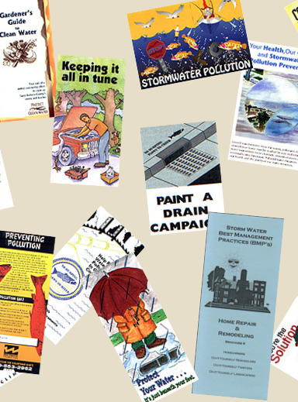
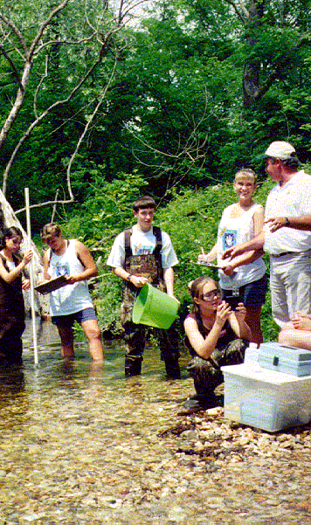
2021 MCM-1 Education and Involvement Strategy
Volunteer stream monitoring.
Stormdrain marking.
Stream cleanup events.
Pollutant collections.
Distribute education items (brochures, etc.).
Use social media and website outreach.
Set Measurable Goals for each BMP.
Use 3rd Party resources (e.g., Blue Thumb).
Keep records of what was done and when.
Notes:
OKR04 requires MS4s to identify “target audiences” which are segments within the MS4’s community that are considered potentially significant sources of pollution.
Table V-1 lists specific types of education methods that should be considered, with each being a BMP.
There are hundreds of different kinds of outreach materials and activities that an MS4 may choose to implement (e.g., brochures, social media, websites, city hall display boards, etc.).
The items in Slide 6 are some of the more common ones used by GCSA members. Records must be kept of everything that was done for each BMP and included in the Annual Report.
Each outreach BMP should be scheduled and assigned a Measurable Goal (MG). The MG is a numerical target goal, such as distributing 50 Pet Waste brochures to homeowners each year.
The SWMP must list each BMP, its deployment schedule and its MG. The MS4’s Annual Report must assess implementation success of each BMP.
Many MS4s take advantage of 3rd party resources for a variety of public education materials and activities.
INCOG has prepared a number of GCSA brochures on many of OKR04’s required outreach topics; these are refreshed periodically.

Slide 7
2021 MCM-2 Requirements for Industrial Stormwater Runoff Control
This MCM-2 only applies to Category 3 MS4s as defined under Part III.B.
MCM-2 program must be consistent with DEQ’s OKR05 stormwater general permit for industrial activities.
Maintain list of OKR05 permittees.
Implement and enforce an ordinance to require BMPs to reduce pollutants.
Implement site inspection and enforcement as outlined in Table V-3.
Evaluate MCM-2 program effectiveness in your Annual Report.
Notes:
This 2nd MCM covered Public Participation in the 2015 OKR04 permit. Public Participation has now been combined with Public Education under MCM-1 in the 2021 OKR04 permit.
The new MCM-2 covers stormwater runoff from industrial sites in Category 3 MS4s.
All Category 3 MS4s must implement MCM-2 in a manner consistent with DEQ’s OKR05 industrial stormwater permit.
Since OKR05 will likely be updated in 2022, any new OKR05 requirements affecting OKR04 Category 3 strategies must be implemented within 2 years following the new OKR05 effective date.
MCM-2 requires Category 3 MS4s to implement and enforce an ordinance or other regulatory mechanism to control stormwater pollution from OKR05 industrial sites.
MCM-2 also requires Category 3 MS4s to “implement and enforce procedures for site inspection and enforcement of control measures…”
The frequency of these industrial site inspections is presented in OKR04 Table V-3.
One of the MCM-2 recommendations is to expand site inspections and enforcement to industrial sites not subject to OKR05.
DEQ is preparing lists and GIS data of all OKR05 permittees in Oklahoma for MS4 use in meeting MCM-2 and other OKR04 permit requirements.

Slide 8
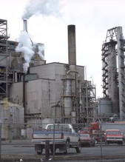
2021 MCM-2 Industrial Pollution Control Strategy
Ensure local program is consistent with latest OKR05 industrial permit.
Annually update list of OKR05 facilities.
Adopt local codes that require BMPs to:
  Minimize exposure,
  Provide good housekeeping,
  Implement preventative maintenance,
  Use spill prevention and response,
  Provide erosion and sediment controls.
Inspect sites as scheduled in Table V-3.
Notes:
Category 3 MS4s will have to keep close scrutiny of the OKR05 industrial stormwater permit’s requirements.
MS4s will have to ensure that all of their MCM-2 requirements in their SWMP and other local procedures conform to the requirements in OKR05.
The 2021 OKR04 permit requires Category 3 MS4s to “implement and enforce an ordinance or other regulatory mechanism…”
The ordinance must “…require BMPs…, provide good housekeeping, preventative maintenance, spill prevention and response, and erosion and sediment controls, as well as sanctions to ensure compliance.”.
Site inspection procedures must be consistent with OKR05 and be conducted at the frequency specified in the 2021 OKR04 Table V-3.
Category 3 MS4s must maintain and annually update a list of all OKR05 permitted industrial facilities within their MS4.
Measurable Goals and schedules for each MCM-2 BMP and activity must be established, records kept of all activities, and an assessment of each BMP included in the MS4’s Annual Report to DEQ.

Slide 9
2021 MCM-3 Requirements for Illicit Discharge Detection & Elimination (IDDE)
Implement IDDE program including DWFS:
  Identify priority areas,
  Trace sources of illicit discharges,
  Remove illicit discharge sources,
  Use visual indicators and field test kits,
  Conduct DWFS inspections per Table V-4,
  Enforce local ordinance to prohibit IDs,
  Annually update a storm sewer map,
  Annually update a list of allowable discharges.
Evaluate MCM-3 program effectiveness in your Annual Report.
Notes:
The “IDDE” MCM-3 is a critical part of the stormwater pollution control program.
It requires each MS4 to look for pollution and sources, and if found, to take action under local codes to eliminate the sources.
An important requirement is to ensure that MS4 employees have adequate training.
Formal procedures must be developed to detect pollution sources, trace the illicit discharge to its source, and remove the source.
A local ordinance “or other regulatory mechanism” must be adopted to “effectively prohibit … non-stormwater discharges into…” the MS4.
MCM-3 was rewritten and reorganized for clarity in the 2021 OKR04 permit.
Dry Weather Field Screening (DWFS) requirements are more clearly stated, and the new Table V-4 specifies the frequency of DWFS inspections overall and for high priority areas.

Slide 10
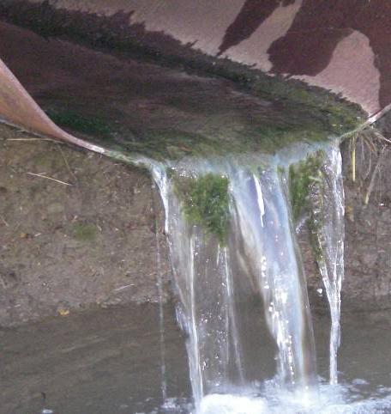
2021 MCM-3 IDDE Strategy
Adopt local ordinance or other mechanism.
Prepare MS4 system map with outfalls.
Perform Dry Weather Field Screen (DWFS) inspections.
Develop priority areas with likelihood of pollution.
Trace pollution sources and enforce controls.
Create system for reporting illicit discharges.
Set Measurable Goals for each BMP.
Keep records of what was done and when.
Notes:
The local ordinance must effectively prohibit illicit discharges. There is no need to list types of pollutants or specify minimum quantities of discharges.
Any pollutant in any quantity is prohibited under the EPA and DEQ stormwater permit rules.
MS4s must develop an MS4 system map showing all “outfalls” and receiving streams. This requirement can be met in a variety of ways, from paper maps to GIS.
DEQ allows each MS4 to define “outfall” locally. Outfalls are used in inspections of illicit discharges and for assessing water quality within the MS4.
Future GCSA Training will address defining and inspections of “outfalls” along with other Quality Assurance (QA) topics.
The new OKR04 permit clarifies how to define and use priority areas for DWFS.
DWFS is a first phase of the IDDE program in which potential illicit discharges are discovered. DWFS leads to more intensive source-tracking inspections
Source-tracking must commence within 72 hours of detection by or being reported to the MS4.
MS4s must also “maintain and annually update a list of occasional incidental non-stormwater discharges or flows as allowed in OKR04 Part II.B.2”.
MS4s must keep good records of all MCM-3 “detection and elimination” activities, including details of inspections and enforcement actions.
Measurable Goals and schedules for each BMP must be set, records kept of all activities, and an assessment of each BMP included in the MS4’s Annual Report to DEQ.

Slide 11
2021 MCM-4 Requirements for Construction Site Runoff Control
Implement and enforce a construction site pollutant reduction program.
Local program shall be consistent with OKR10 which covers sites ≥ 1 acre of land disturbance.
OKR10 also covers smaller sites in a Common Plan of Development.
Adopt ordinance to control construction site pollution including sediment, chemicals & trash.
Implement process for site plan reviews.
Construction site inspections and enforcement.
Evaluate MCM-4 program effectiveness in your Annual Report.
Notes:
This MCM was listed as one of the 11 “Industrial Activities” in the original 1990 EPA Phase I stormwater rules.
It was given its own Phase I permit program under DEQ’s OKR10 construction general permit. OKR04 also requires MS4s to control construction pollution locally as a Phase II requirement.
The 2021 OKR04 permit clarifies that its MCM-4 construction requirements must be consistent with OKR10.
In doing this, DEQ deleted around 40 pages of OKR10 passages that were in the 2015 permit because the same requirements are presented in OKR10.
MCM-4 requires the MS4 to implement a program “to reduce pollutants in any stormwater runoff to your MS4 from construction activities”.
OKR10 sets a site disturbance size of ≥ 1 acre or for smaller disturbances that are part of a larger Common Plan of Development.
The MS4 must adopt a local ordinance or other regulatory mechanism “to require erosion and sediment controls as well as sanctions to ensure compliance” where feasible.
OKR10, and thus OKR04 as well, requires implementation of a Stormwater Pollution Prevention Plan (SWP3) that covers all construction site pollution.
OKR04 requires MS4s to “implement and enforcement procedures for site plan review which incorporate consideration of potential water quality impacts…”.
MCM-4 also requires MS4s to inspect and enforce the effective use of on-site control measures, including local use of escalating penalties for repeat offenders.

Slide 12
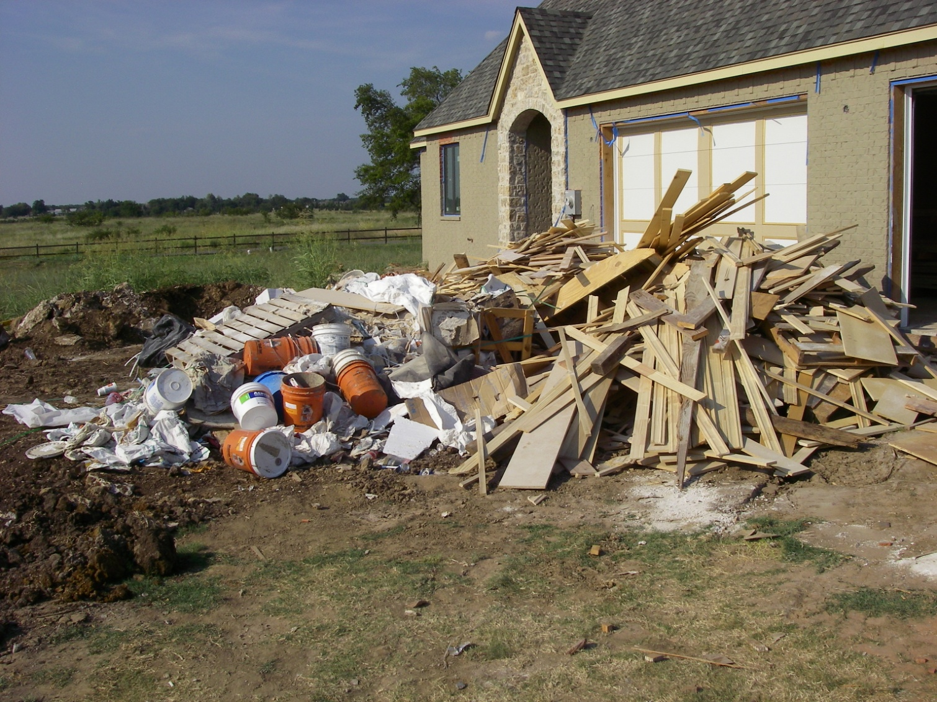
2021 MCM-4 Construction Strategy
Set local program to be consistent with OKR10.
Adopt local ordinance or other mechanism.
Require developers to implement BMPs.
Inspect sites and enforce pollution violations.
Site Plan reviews must consider water quality.
Act on information submitted by the public.
Set Measurable Goals for each BMP.
Keep records of what was done and when.
Notes:
OKR04 requires that the MCM-4 program be consistent with the OKR10 permit.
Since OKR10 will likely be updated in 2022, any new OKR10 requirements affecting the OKR04 MCM-4 local program must be updated within 2 years.
MS4s must adopt local codes “or other regulatory mechanisms” that provide effective pollution prohibitions and have escalating enforcement provisions.
MS4s must require developers to implement on-site BMPs to “require erosion and sediment controls” including BMPs to control all other construction site pollution.
Table V-5 in the 2021 OKR04 permit requires construction site inspection frequencies for 5 different conditions based upon MS4 Category.
MCM-4 requires the MS4 to “implement and enforce procedures for site plan review which incorporate consideration of potential water quality impacts”.
This requirement will affect Public Works and Engineering departments involved in site plan reviews.
MCM-2 requires the MS4 to develop procedures for receiving reports of pollution from the public, including from construction sites. MCM-3 requires MS4s to respond to reports.
MS4s must keep good records of all MCM-4 construction BMPs, including details of inspections and enforcement actions.
Measurable Goals and schedules for each MCM-4 BMP must be set, records kept of all activities, and an assessment of each BMP included in the MS4’s Annual Report to DEQ.

Slide 13
2021 MCM-5 Requirements for Post-Construction for New and Redevelopment
Implement and enforce a program to reduce pollution from new and redevelopment.
Covers sites ≥ 1 acre of land disturbance or smaller sites in a Common Plan of Development.
Adopt local code to address post-construction runoff from new and redevelopment.
Remove LID Barriers in local codes where feasible.
Provide opportunities to promote LID.
Ensure long-term maintenance of on-site BMPs.
Assess designs of impervious surfaces, and promote LID design options.
Evaluate MCM-5 program effectiveness in your Annual Report.
Notes:
MCM-5 addresses pollution from the project itself, not its construction. MCM-5 applies throughout the life of the completed project, referred to as “post-construction”.
LID is the basis for on-site post-construction pollution control.
Over the years, the Post-Construction MCM-5 has been difficult to address nationwide. When EPA’s Phase II rules were finalized in 1999, LID and Green Infrastructure were not well known.
Most developers refused to adopt LID fearing it would raise project costs too much, and others could not find reliable LID resources.
Now 20 years later, LID methods are in much wider use, LID education and awareness has matured, and developers are finding LID interest from their clients.
MCM-5 requires the MS4 to implement a program “to address stormwater runoff from new development and redevelopment projects that disturb greater than or equal to one acre”
MCM-5 also covers smaller projects that are part of a larger Common Plan of Development.
MS4s must adopt local codes that encourage or require post-construction pollution control and identify and remove, where feasible, barriers to LID in local codes.
MS4s must also identify “opportunities to promote LID” through local strategies and codes.
MS4s must also implement plans to ensure long-term maintenance of on-site BMPs and educate developers and the public about the benefits of LID.

Slide 14
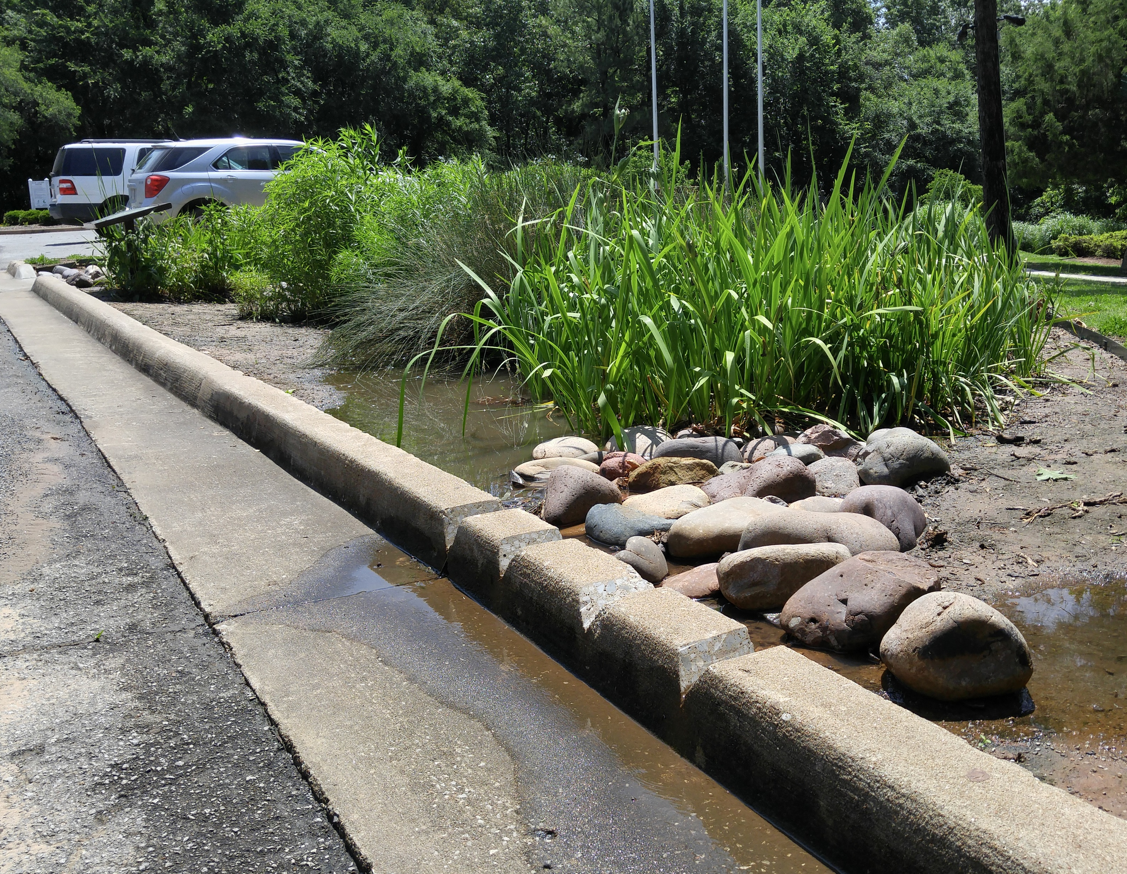
2021 MCM-5 Post-Construction Strategy
Adopt local ordinance or other mechanism.
Require developers to implement BMPs.
Inspect sites for adequate BMP maintenance.
Review local codes and remove LID barriers.
Encourage or require LID strategies in designs.
Inspect O&M of BMPs.
Set Measurable Goals for each BMP.
Keep records of what was done and when.
Notes:
MS4s must adopt local codes “or other regulatory mechanisms” that “address post-construction runoff”.
MCM-5 requires that the MS4 program “must maintain pre-development runoff conditions and ensure that controls are in place that would prevent or minimize water quality impacts.”
MS4s must review their local codes and remove LID barriers where feasible.
Such code barriers might include mandatory sidewalks (which increase impervious cover), or mandatory detention basins in new subdivisions without allowing LID alternatives.
MCM-5 also requires the MS4 to identify “opportunities to promote LID” and remove any opportunity barriers. DEQ considers this to mainly apply to promotion in local codes.
Barriers to LID opportunities or in local codes can be kept, but the MS4 must “provide a justification” as to why the barrier was not removed.
MCM-5 will affect a city’s public works, engineering and planning departments by requiring considerations for LID within their community.
The MCM-5 requirement to implement procedures “to ensure adequate long-term operation and maintenance of BMPs” must include inspections performed by the MS4.
MS4s must keep good records of all of their MCM-5 activities, including details of BMP inspections performed.
Measurable Goals and schedules for each MCM-5 BMP must be set, records kept of all activities, and an assessment of each BMP included in the MS4’s Annual Report to DEQ.

Slide 15
2021 MCM-6 Requirements for Good Housekeeping for MS4 Operations
Implement O&M and training programs that apply to all “MS4 Operations” including the MS4 collection system.
Annually update list of OKR05 permittees.
Implement BMPs during maintenance and repairs of municipal systems.
Ensure vehicle wash water does not enter MS4.
Assess new flood management projects for water quality impacts.
Contractors must also comply with MCM-6.
Inspect and maintain structural and nonstructural BMPs per Table V-6.
Evaluate MCM-6 program effectiveness in your Annual Report.
Notes:
This “Good Housekeeping” MCM-6 requires MS4s to apply stormwater pollution controls to all of their municipally-owned facilities and their MS4 stormwater collection system.
In the early years of the program, most efforts focused on municipal maintenance and storage areas for vehicles, heavy equipment and materials.
The 2021 OKR04 permit clarifies that pollution prevention also includes the MS4’s stormwater collection system as part of the “MS4 Operations”.
Under OKR04, MS4 Operations includes municipally-owned streets, drainage ditches, culverts and detention basins.
MCM-6 requires that employees be trained on preventing stormwater pollution from municipal activities at a frequency defined in Table V-2.
MS4s must maintain a list of all industrial facilities within their MS4 that have OKR05 industrial stormwater permits.
MS4s must implement “BMPs including sediment and erosion controls during” routine maintenance, water line breaks and emergency repairs, and stabilize within 14 days.
MS4s must ensure that vehicle wash waters from MS4 facilities are not discharged into the MS4 or Waters of the State.
New flood management projects such as detention basins must be assessed for impacts on water quality.
MS4s must implement an inspection and maintenance program of structural and non-structural BMPs to reduce floatables and other stormwater pollutants
The schedule of Inspection frequency is presented in OKR04 Table V-6.

Slide 16
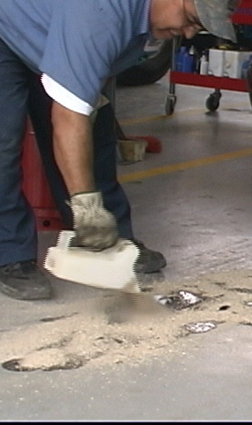
2021 MCM-6 Good Housekeeping Strategy
Train employees on controlling pollution in the workplace and within the MS4.
Implement BMPs to control pollution in runoff from municipal facilities and the MS4.
Inspect municipal facilities and MS4 for adequate BMP function and maintenance.
Assess new flood management projects for water quality impacts prior to final plans.
Set Measurable Goals for each BMP.
Keep records of what was done and when.
Notes:
The 2015 OKR04 MCM-6 required these specific employee training topics: “park and open space maintenance, fleet and building maintenance, new construction and land disturbances, and stormwater system maintenance.”
The 2021 OKR04 MCM-6 training changes this to training that “has the ultimate goal of preventing or reducing pollutant runoff from MS4 operations…”
2021 OKR04 defines MS4 operations “such as streets, roads, highways, parking lots, maintenance and storage yards, fueling areas, waste transfer stations, fleet or maintenance shops, salt/sand storage locations and snow disposal areas.”
Good Housekeeping BMPs should focus on controlling pollution from municipal operations and facilities, including maintenance of the MS4 system.
Municipal facilities and the MS4 system must be inspected to ensure adequacy of structural and nonstructural BMPs and pollution reduction effectiveness.
Table V-6 in the 2021 OKR04 permit specifies inspection frequencies for OKR05 and other MS4 facilities.
Proposed new flood management projects must be assessed prior to final plans for potential impacts on water quality from stormwater pollution.
Measurable Goals and schedules for each MCM-6 BMP must be set, records kept of all activities, and an assessment of each BMP included in the MS4’s Annual Report to DEQ.

Slide 17

This ends Part 3 of Stormwater 101 Training
Notes:
This ends Part 3 of INCOG’s Stormwater 101 Workbook series on the basics of stormwater permitting and water quality protection.
Part 4, the final in this GCSA Stormwater 101 training series, will address the four categories of special sensitive waters.
Please contact INCOG at stormwater@incog.org or (918) 579-9451 if you have any questions about GCSA or the material in this document.

